Slide 1
Video Games Metacritic Score Prediction Modeling for Metacritic Score
Presented by: Samuel Diaz

Slide 2
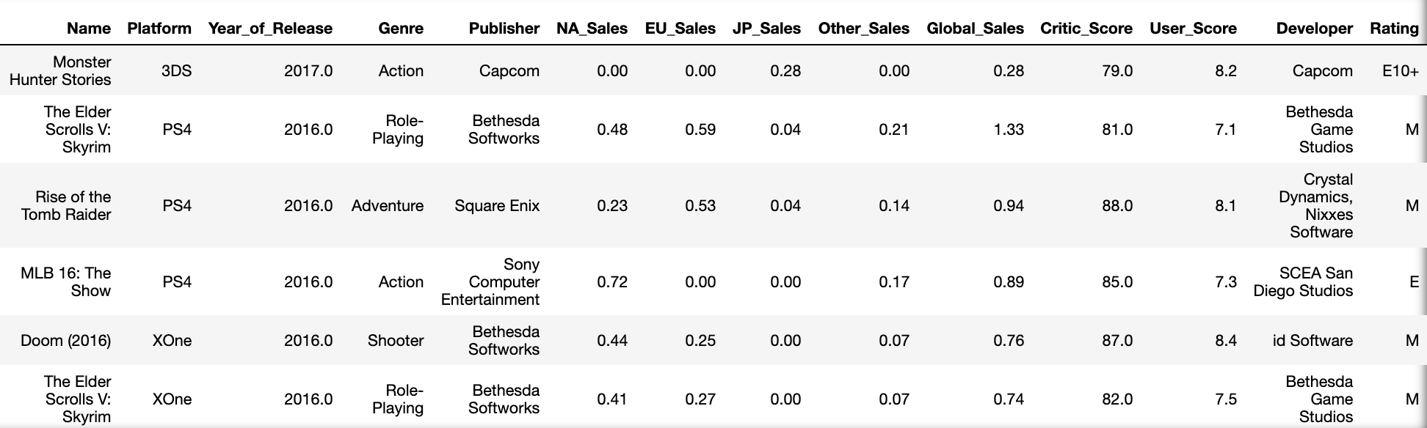
Data Set
I use a data set from Kaggle and I also did some api calls for additional information on the Platforms for the games

Slide 3
Distribution
Plotted all numerical data to analyze the distribution of each category separately.

Slide 4

Distribution pt. 2
Distribution Pt2
Plotted all numerical data to analyze the distribution of each category against the other categories. To see the relationships between categories with a color hue showing the different Platforms for the games. I then made dummy variables for non numerical values.

Slide 5
Visualizing by Critic score vs Sales
Fig. 1 Shows the relationship between Metacritic score and Global sales of the game.
Based on this graph you can say there seems to be a slight correlation.

Slide 6
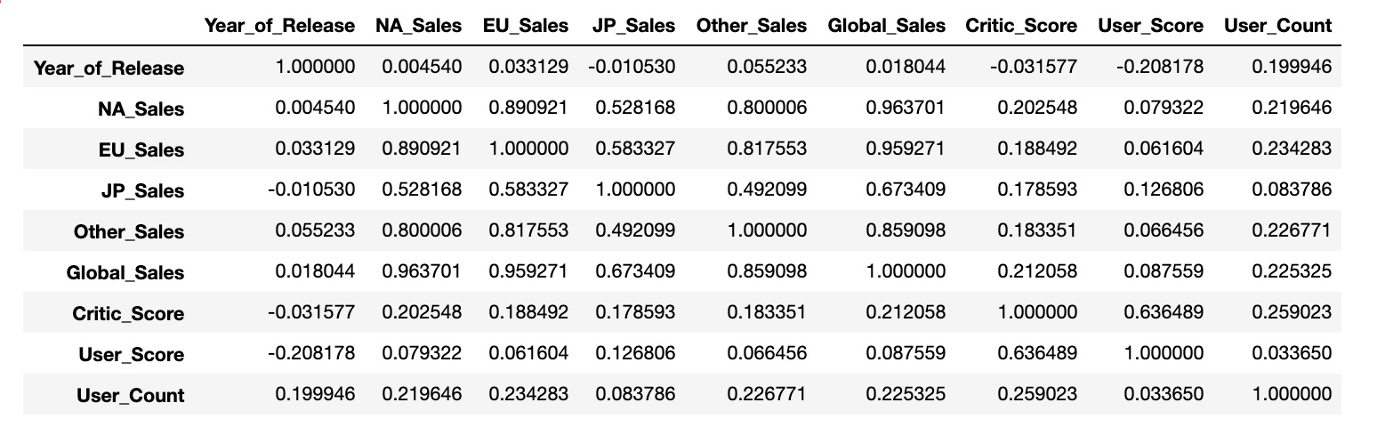
Correlation
Shows correlation between each numerical features against all others

Slide 7
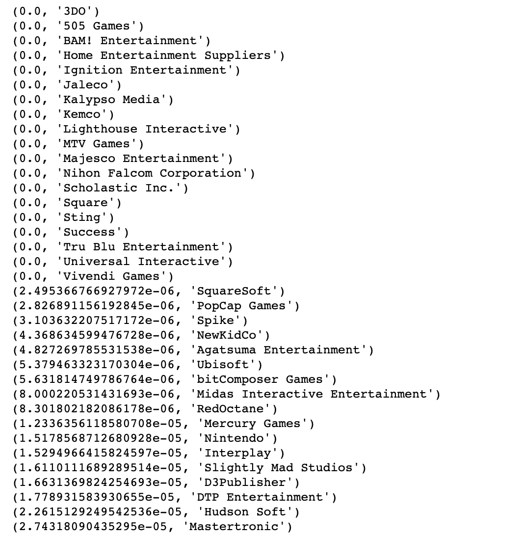
Classification for Critic's Score
Features with no significance I removed them
I classified three categories for ranges of Metacritic scores:
3 if the game had a score higher then 7.5
2 if the game had a score between 5.1-7.4
1 if the game had a score lower then 5.0
Also had to feature engineer to get a more accurate predictions

Slide 8
Visualizing Classified Critic Scores – Against Platforms & Genres

Slide 9
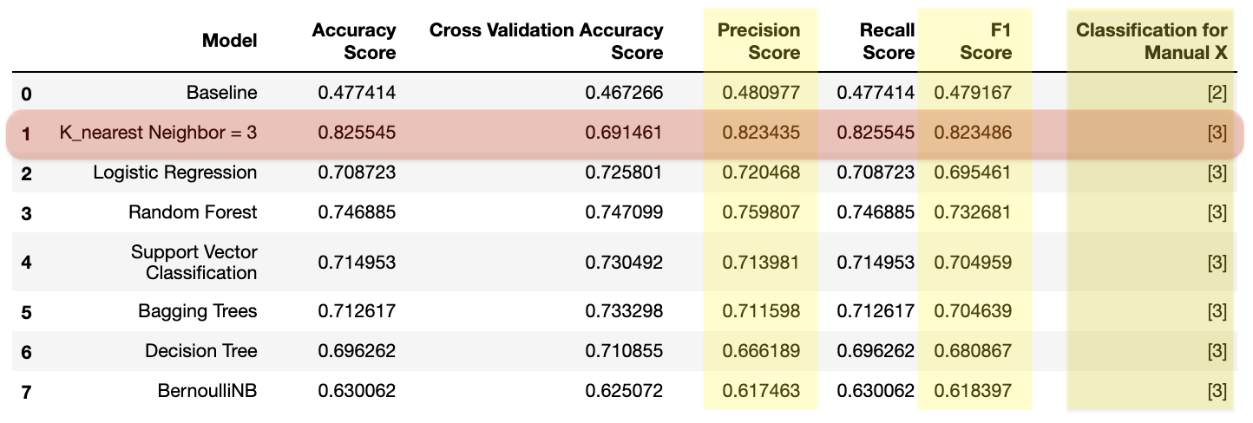
Models
I ran my data through DummyClassifier ,KNN , Logistic Regression, Random Forest, Support Vector Classification, Decision Tree and Bernoulli NB models. And it seemed KNN worked the best.

Slide 10
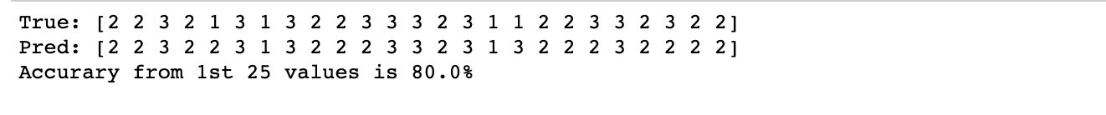
Final Conclusion
K_nearest Neighbor = 5 Regression train accuracy is 0.6439545758183033
K_nearest Neighbor = 5 Regression test accuracy is 0.7437694704049844
K_nearest Neighbor = 5 Prediction accuracy is: 0.7437694704049844
K_nearest Neighbor = 5 Mean cross validation is: 0.6282787768110097
K_nearest Neighbor = 5 Precision score is: 0.7458290585870638
K_nearest Neighbor = 5 Prediction recall score is: 0.7437694704049844
K_nearest Neighbor = 5 Prediction f1 score is: 0.7385703525214701
Manually selected a sampling of Actual vs Predicted Values from KNN and calucated Accuracy

Slide 11
APPENDIX
Other useful information

Slide 12







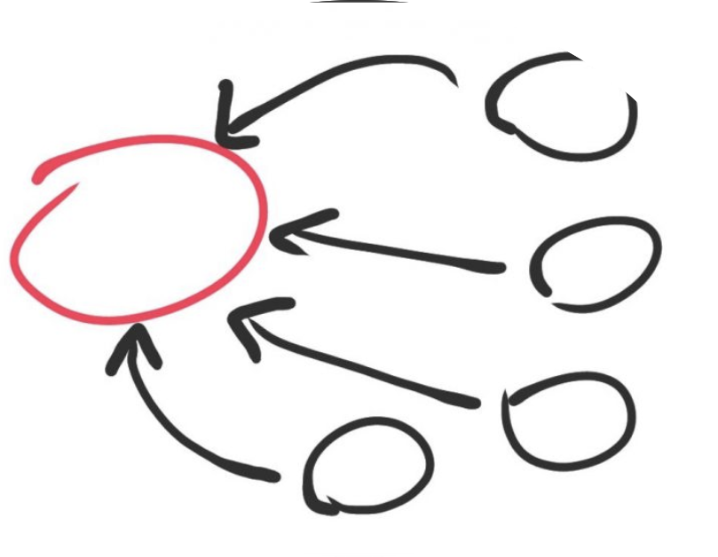
WORKFLOW :
1) Brainstorm
2) Collecting Data / Cleaning Data
3) Organize Data
4) Generated our Hypotheses
5) Data Analysis
6) Calculating Statistical values
7) Data Visualization
8) Rejecting or failing to reject our Hypotheses
8) Conclusion

Slide 13
Limitations
Time - more time to clean more data, for more parameters to filter through
Collecting data - to collect data from more sources to collect more game data
Running more statistical tests/models
Not having a partner…

